Slide 1








CAFE MANAGEMENT SYSTEM

Slide 2
Our Team
1.RAKESH C RTU24101CS014
2.DARSHAN D RTU24101CS015
3.MANISH M RTU24101CS021
4.G ROSHAN ZAMEER RTU24101CS035

Slide 3
Abstract
The Primary Goal of this project is to manage the Human error and also to save the time during billing. This records the all customer transactions during billing. Users can modify the menu items, Can check the tax on their orders taken. All data is stored in lightweight database and easy to maintain and also easy to understand.

Slide 4

Introduction
This project, cafe management system using python is develop to address these challenges by offering complete digital solution without human error for small/medium sized cafes. This system is designed to calculate bills and maintaining the menus, taking orders and generate bills. It helps for customer to process the order early and takes less time than traditional methods.

Slide 5

ADVANTAGES
User-Friendly GUI
Automated Billing
Database Storage (SQLite)
Flexibility
Error Handling
Portability
Multiple Functionalities
Cost Effective

Slide 6

Goals
To design and develop an AI-Based Cafe management system which can generate E-Bills Easily
To Consume Time by which the orders can maintain fastly and also easily
To Store the data of orders taken, money collection for each order.
To Provide E-Bills as well as Menu by understanding customers needs in cafe.
To lay the foundation for future enhancemets such as E-bill , E-Data and also storing menu.

Slide 7

Methodology
The system is implemented in Python with three main modules:
1. GUI Module (Tkinter): Handles the user interface, including buttons, labels, entry fields, and the layout of widgets.
2. Billing Logic: Calculates total price based on item quantities and predefined prices. Adds tax (e.g., 5%) and formats the bill summary.
3. Database Integration (SQLite3): Every transaction is recorded in a local database with the item name, quantity, total price, and timestamp.

Slide 8
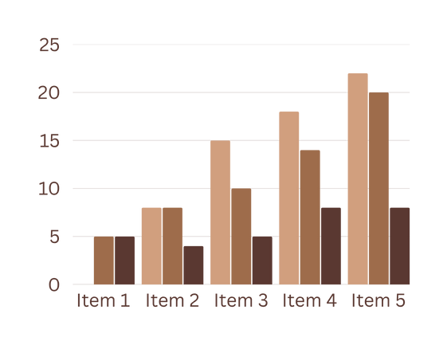
Result
• Takes orders through a graphical user interface (GUI).
Accurately calculates the total bill, including tax.
Displays a clear bill summary for the customer.
• Saves order details (items, quantities, total, timestamp) in a local SQLite database.
• Prevents invalid inputs through basic error checking.

Slide 9
Conclusion
The system is user-friendly, cost-effective, and easy to maintain. It eliminates manual billing errors and reduces the workload on staff. With a modular and scalable design, it also provides a solid foundation for future enhancements such as inventory management, user login, and advanced reporting features.

Slide 10
Thank
You

